Slide 1
Tablets of Stone
Students will model the network communication in Internet by passing a secret message via an unreliable messenger
Notes:
Pages 533 - 541

Slide 2
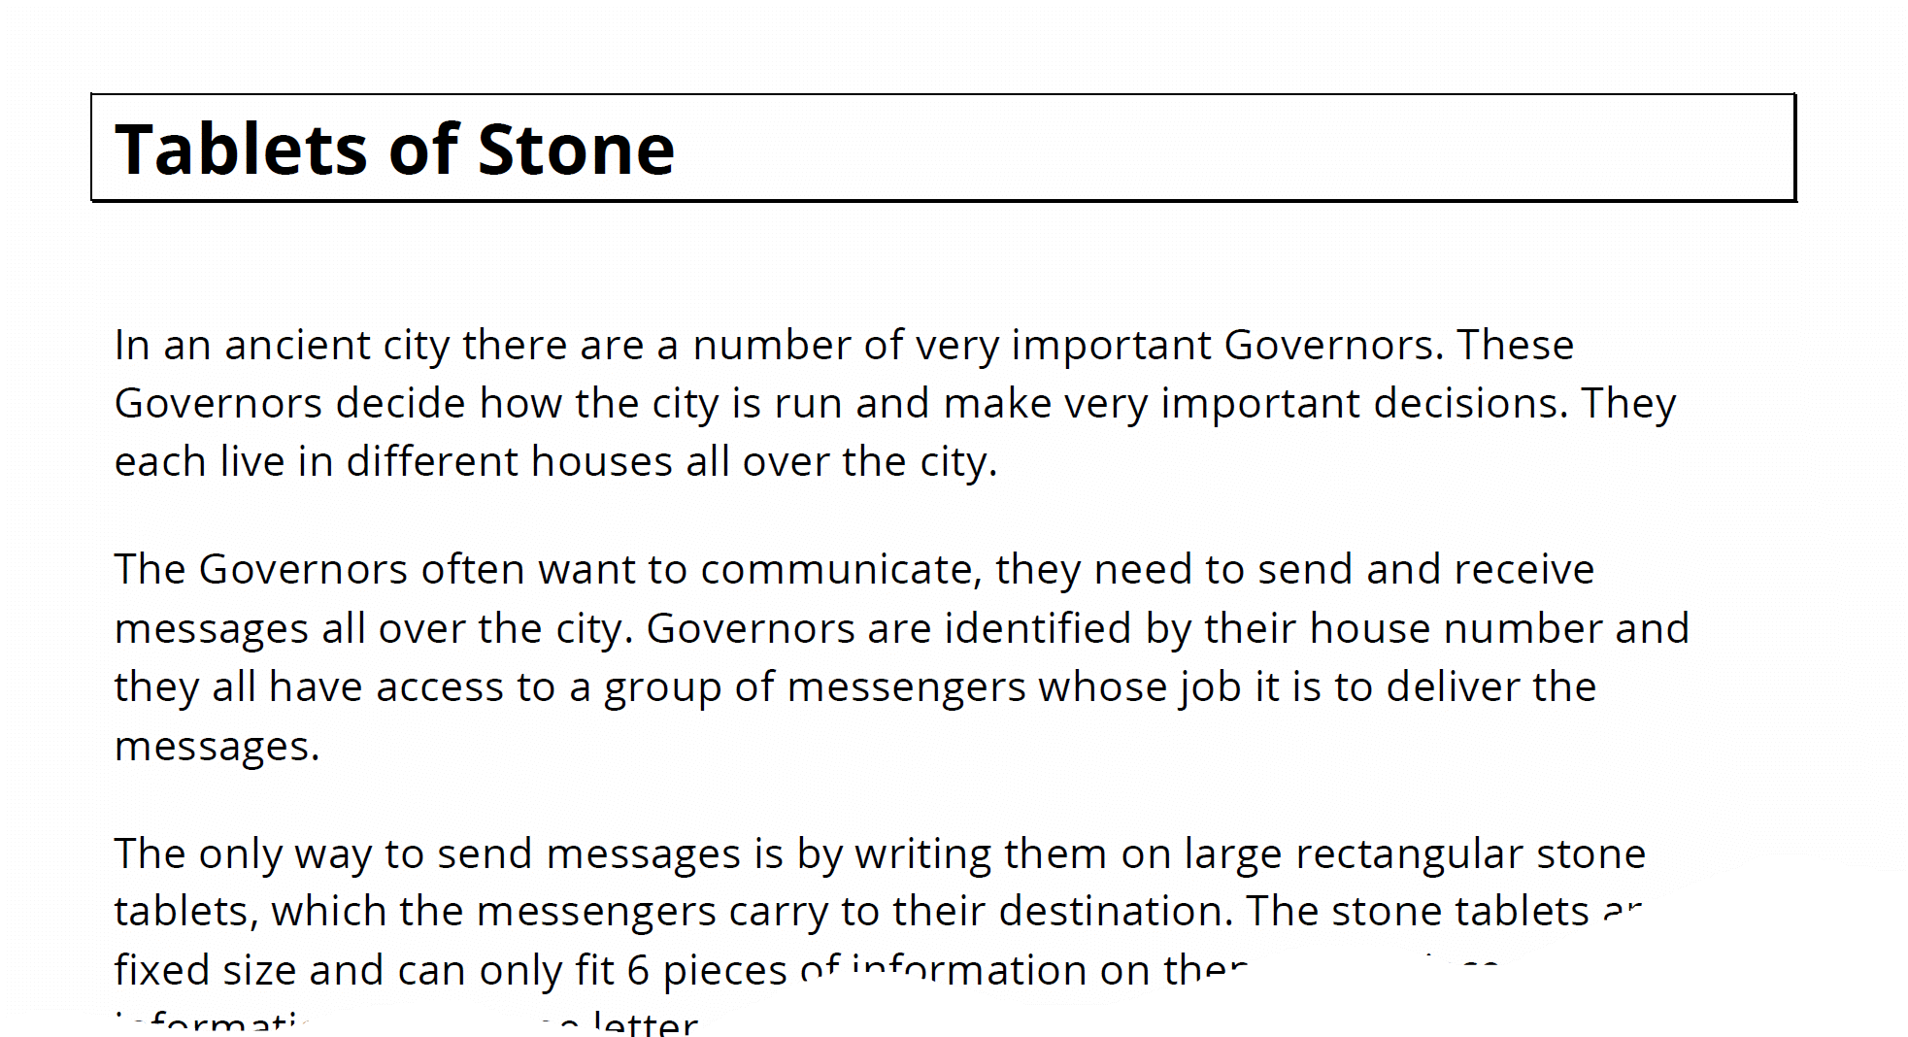





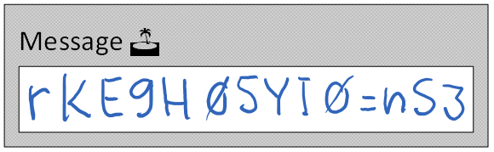
Rules of the game...
Read the file "Tablets of Stone Description" pdf.
Choose partners and a name for your team.
Move with your partners to one side of the room, leaving the center tables empty.
On one side of the room we have the sender teams, on the other we have the receiver teams.
Teacher / TAs are the messengers.
The senders are given a secret message:
Senders can communicate with receivers only through short but unlimited number of messages:
Each message contains the sender and receiver names, and 6 bits (characters) of information.
Messages are transported by the messengers. They are unreliable. They can drop or reorder messages.
Your mission: make the secret message to "materialize" at a receiver team.

Slide 3






IP Networking basics
4070
443
Alice
1433
Julia
IP: 172.39.122.24
IP: 172.39.122.57
IP: 172.39.122.185
port: 53082
port: 5025
port: 53809
Hello, I’m Alice
Hi Alice
Hello, I’m Julia
Hi Julia
Any message for Julia?
Nothing yet
Relay please Greetings from Alice to Julia
OK
Any message for Julia?
Any message for Julia?
Yes: Greetings from Alice to Julia
Hey, you’re not Julia!
Julia signing out!
Goodbye Julia!
time
time
time

Slide 4

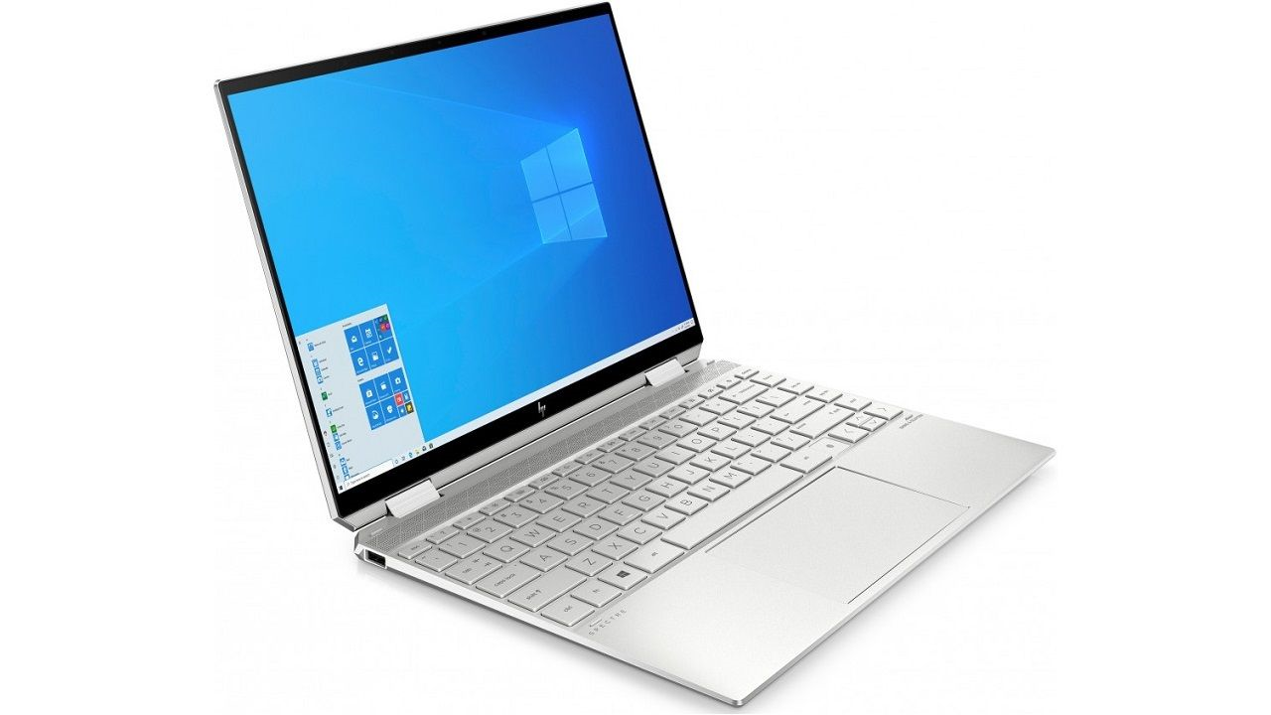
the Networking protocol
Server
Client A
Client B
IP: 172.39.122.24
IP: 172.39.122.57
IP: 172.39.122.185
port: 53082
port: 5025
port: 53809
Message type: Login
Name: “Alice”
Message type: Status
Status: “OK”
Message type: Receive
Name: “Alice”
Message type: Send
From: “Alice”
To: “Julia” Data: [‘h’,’e’,’l’,’l’,’o’,’!’]
Message type: Status
Status: “Err: No Msg”
Message type: Status
Status: “OK”
Message type: Receive
Name: “Alice”
Message type: Logout
Name: “Alice”
Message type: Send
From: “Alice”
To: “Julia” Data: [‘h’,’e’,’l’,’l’,’o’,’!’]
Message type: Status
Status: “OK”
time
time
time

Slide 5
java Sockets API
class Socket
This class implements client sockets (also called just "sockets"). A socket is an endpoint for communication between two machines.
Socket(String host, int port)
 | Creates a stream socket and connects it to the specified port number on the named host.
InetAddress getInetAddress()
 | Returns the address to which the socket is connected.
OutputStream getOutputStream()
 | Returns an output stream for this socket.
InputStream getInputStream()
 | Returns an input stream for this socket.
void close()
 | Closes this socket.
class InetAddress
This class represents an Internet Protocol (IP) address. An IP address is either a 32-bit or 128-bit unsigned number used by IP, a lower-level protocol on which protocols like UDP and TCP are built.
static InetAddress getLocalHost()
 | Returns the address of the local host. This is achieved by retrieving the name of the host from the system, then resolving that name into an InetAddress.
String getHostAddress()
 | Returns the IP address string in textual presentation.
boolean equals(Object obj)
 | Compares this InetAddress against another InetAddress given in the parameter obj.
class ObjectOutputStream
An ObjectOutputStream writes primitive data types and graphs of Java objects to an OutputStream.
ObjectOutputStream(OutputStream out)
 | Creates an ObjectOutputStream that writes to the specified OutputStream..
void writeObject(Object obj)
 | Writes the specified object to the ObjectOutputStream.
class ServerSocket
This class implements client sockets (also called just "sockets"). A socket is an endpoint for communication between two machines.
ServerSocket(int port)
 | Creates a server socket, bound to the specified port.
Socket accept()
 | Listens for a connection to be made to this socket and accepts it. When a connection is made, returns the Socket connected to the other endpoint.
void close()
 | Closes this socket.
class ObjectInputStream
An ObjectInputStream deserializes primitive data and objects previously written using an ObjectOutputStream.
ObjectInputStream(InputStream in)
 | Creates an ObjectInputStream that reads from the specified InputStream.
Object readObject()
 | Read an object from the ObjectInputStream.

Slide 6
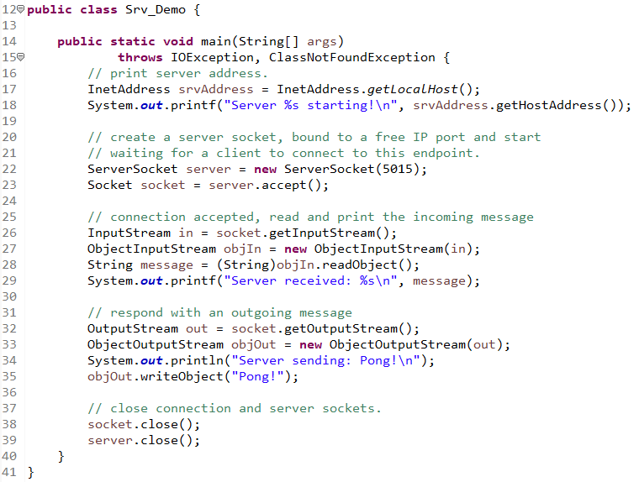
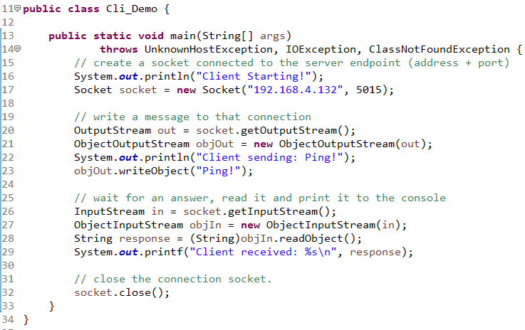
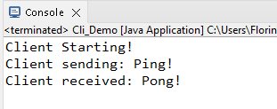
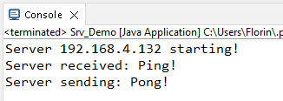
java Sockets example

